Slide 1

SUPMIS
Supply and Property
Management Information System

Slide 2
SUPMIS
SUPMIS is a Web-Based System which supports the Supply Officer to track, monitor and Issue Supplies and Equipment.
It will also assist the employee for monitoring the available stock and requesting Supplies/Equipment.
And It also helps the Accounting and SPMO for their Reports related to Supply/Equipment.

Slide 3



TIMELINE
USERS
Scope

Slide 4
SUPMIS Timeline
Feb 2021 to June 2021
March 2020
July 2019 to Dec 2019
Dec 2020
April 2020 to Dec. 2020
SUPMIS v2
SUPMIS v2
ICO checked the System
Recommendations were given upon checking and Accomplished said tasks within a period of time
Implementation for Encoding of Old Records of RIS/ICS/PAR
SUPMIS v2
SUPMIS v2
SUPMIS v1
Studying the Offline Windows Software
Planning and Data Gathering
System Design.
Web-based System
Developing of SUPMIS v2
Encoding of Old RIS/ICS/PAR
Issuance of RIS/ICS/PAR
Offline Windows System
Encoding of Old RIS/ICS/PAR

Slide 5
TIMELINE
USERS
Scope

Slide 6
SUPMIS Users
Supply Officer
in Stock Room
President
Accounting
Supply Officer
in SPMO
Employee
Supply Coordinator per Department

Slide 7
TIMELINE
USERS
Scope

Slide 8
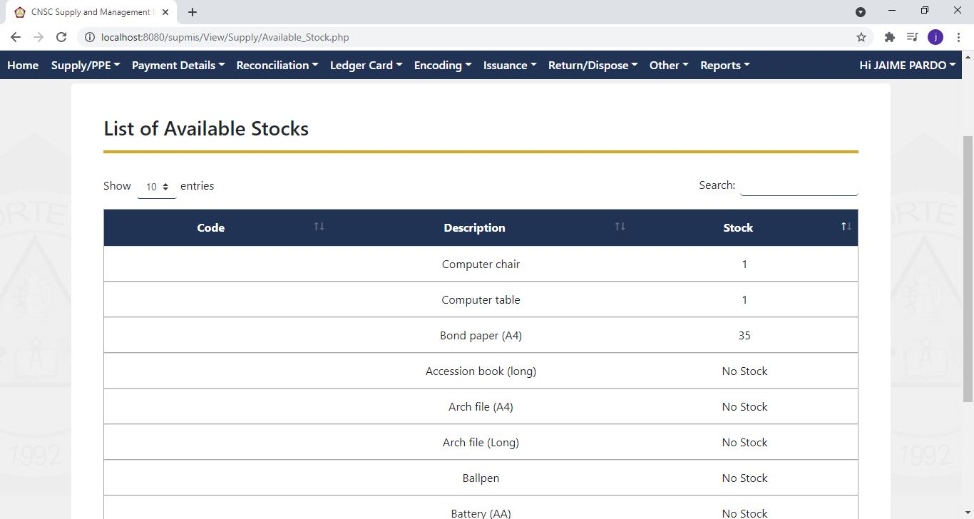
Monitoring of Supplies/Equipment Stocks

Slide 9
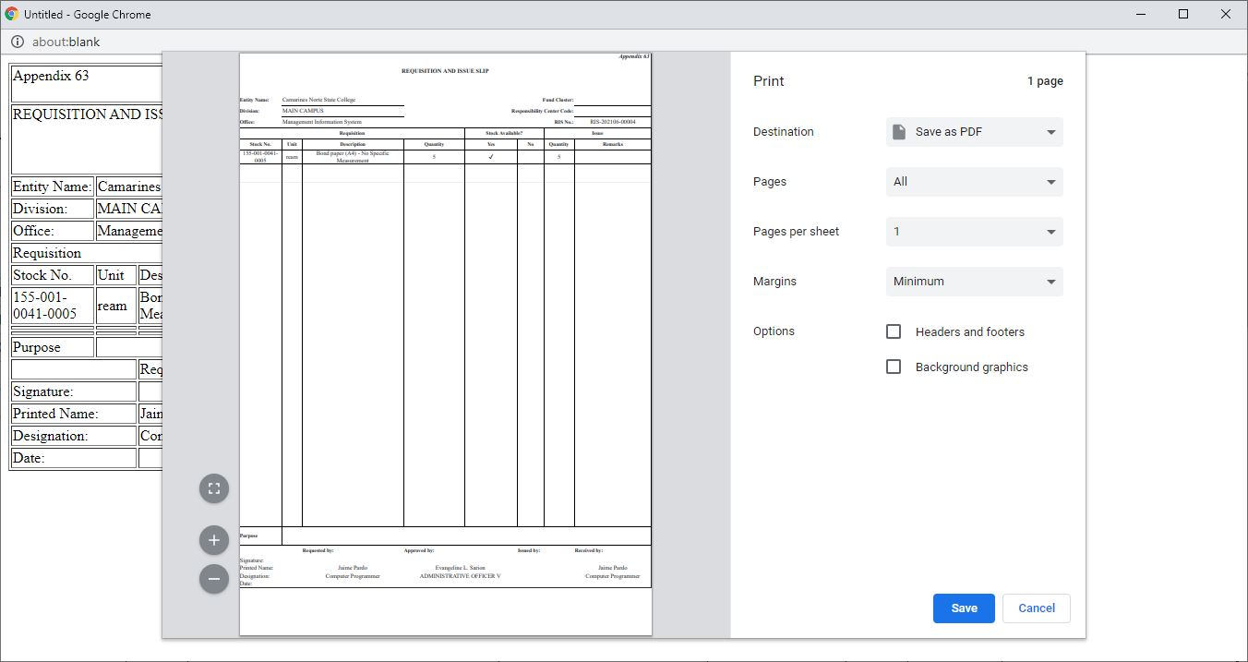
Issuance, Reissuance and Encoding of RIS/ICS/PAR

Slide 10
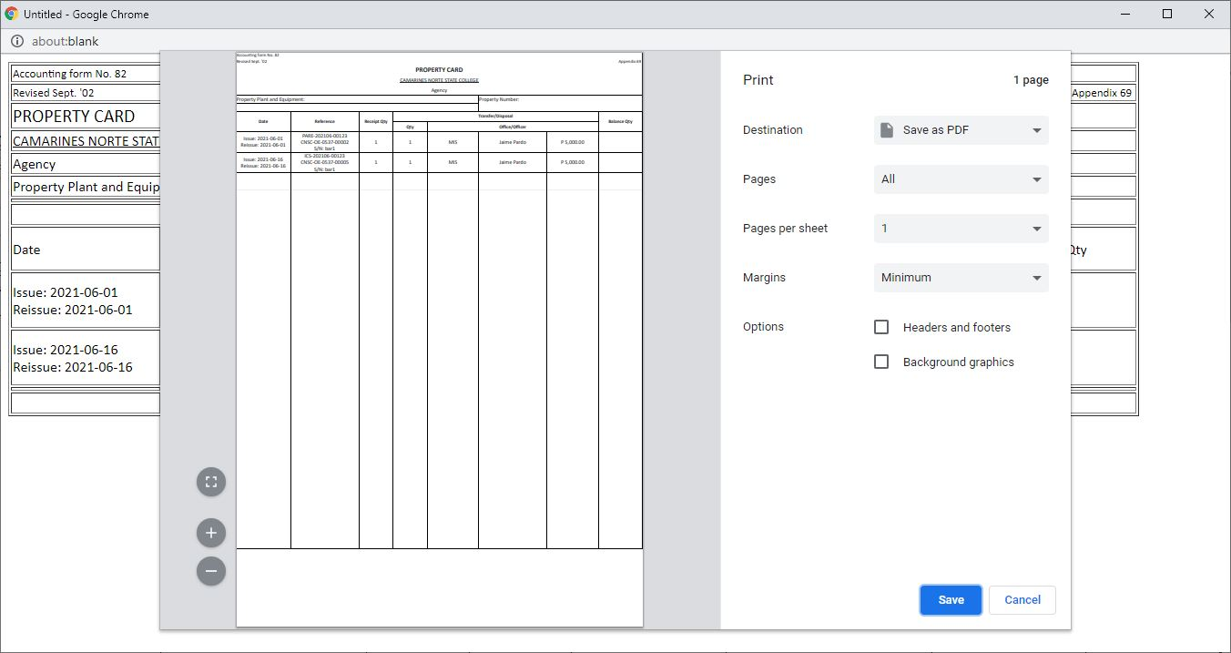
Generation of Supply Reports like Property & Stock Card

Slide 11
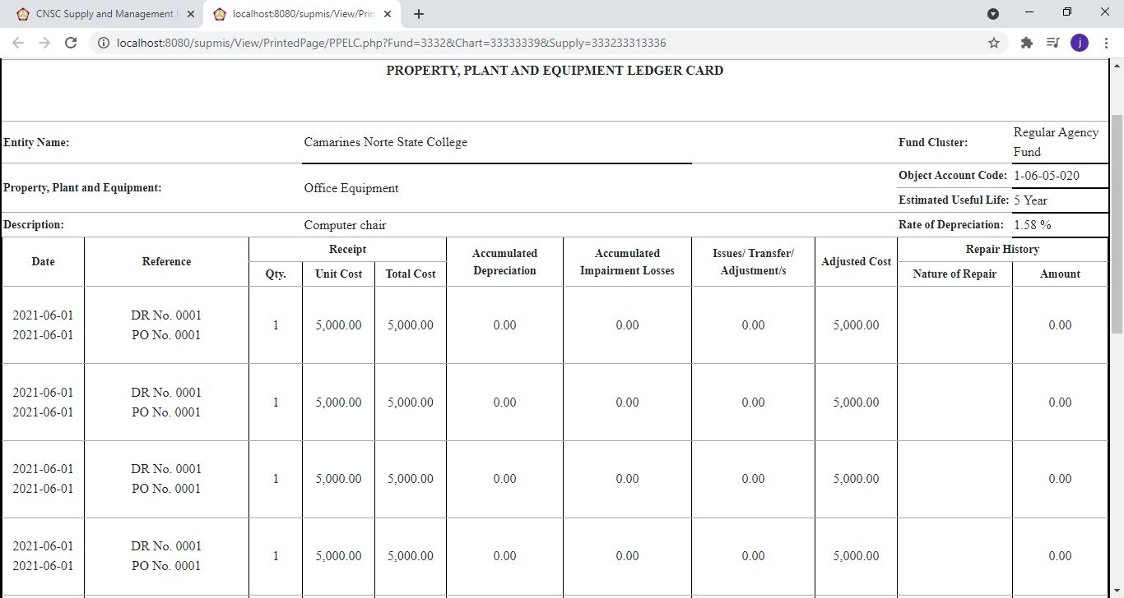
Generation of Ledger Card for Accounting Reports

Slide 12
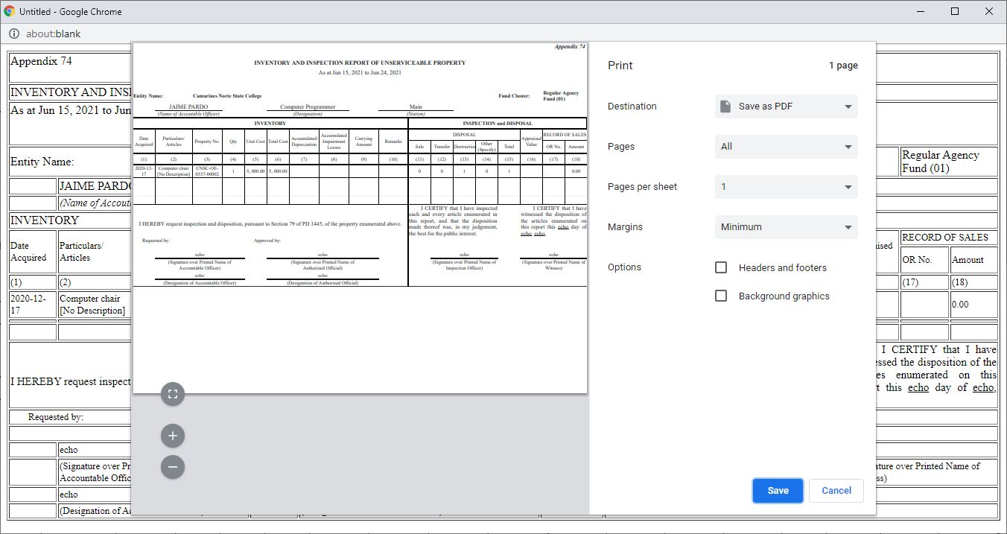
Disposal of Equipment (WMR & IIRUP)

Slide 13
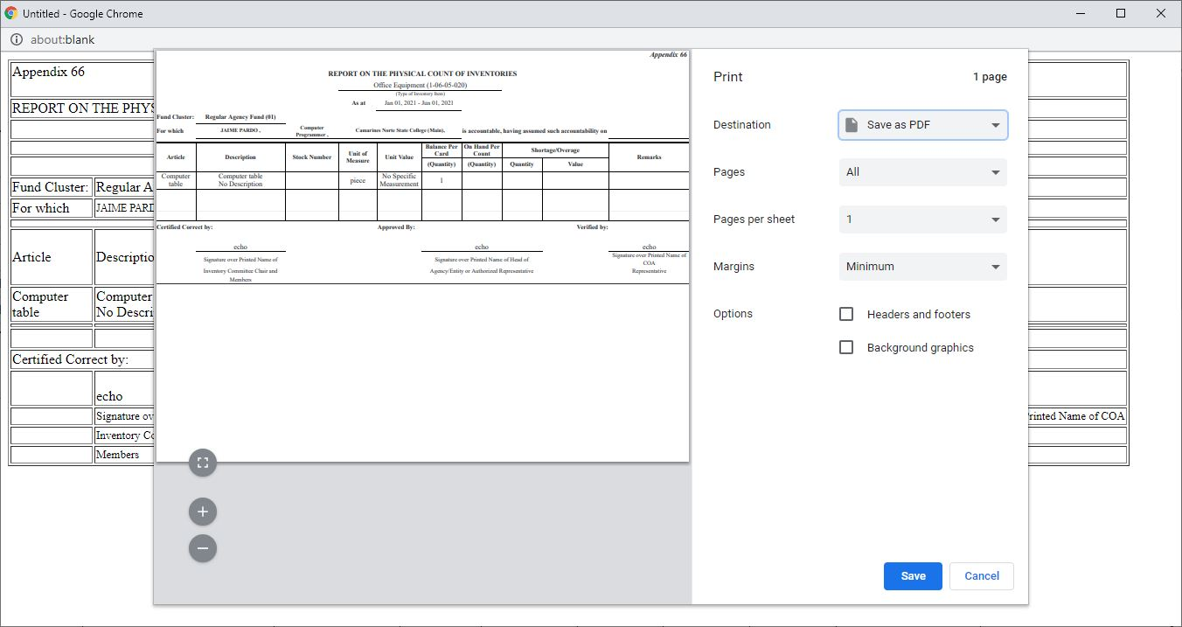
Generation of GAM Reports related in SUPMIS

Slide 14
THANK YOU ☺

